Slide 1


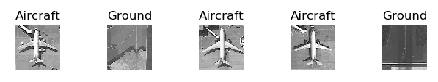
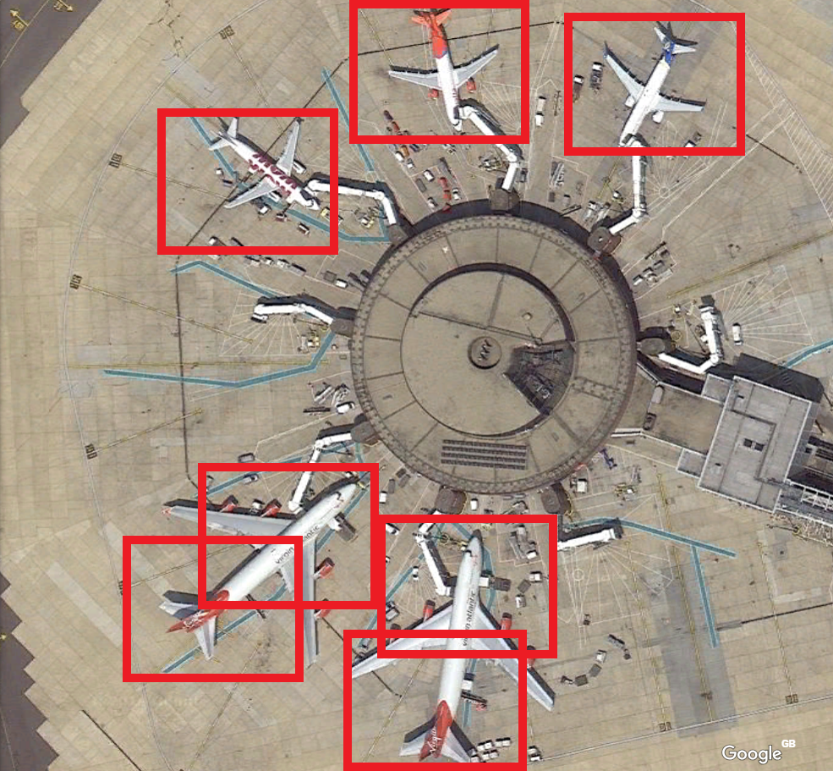
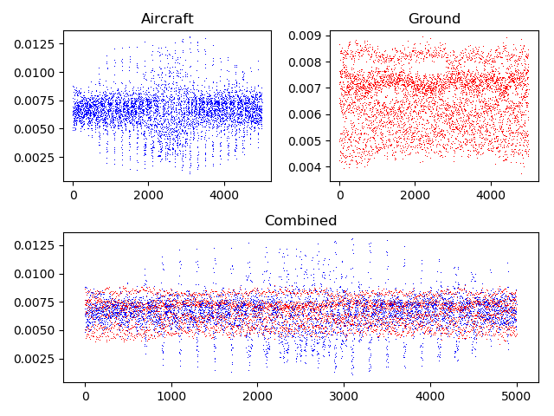
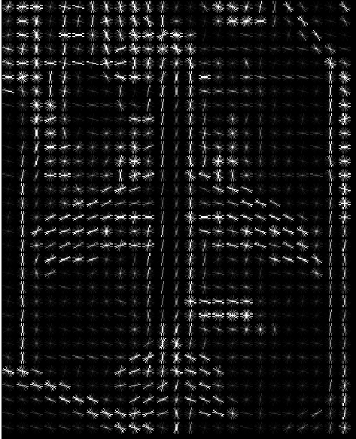
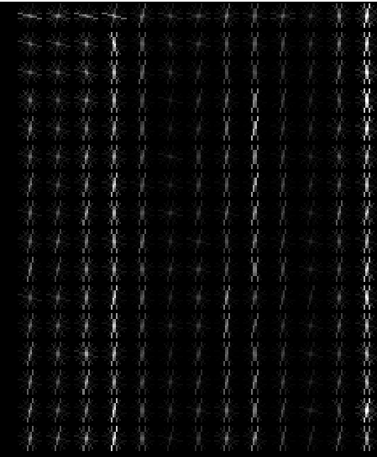
Identifying Aircraft from Above
Kai Roper-Blackman supervised by Sebastian Halder
Objectives:
To differentiate between aircraft and ground images
To identify aircraft of various sizes and orientations in an image specified by the user
Methods:
Histogram of Oriented Gradients used to obtain feature descriptor.
Support Vector Machine passed feature descriptor to differentiate between aircraft and ground.
Testing:
Cross validation score of standalone images reached 100%
Results:
Ground images have a low variance in gradient whereas Aircraft have a large variance
Detection of aircraft in larger images results in accuracy of 50%-60%

